Slide 1




Ministry of Electronics and Information Technology
Government of India
Introduction to Parallel Programming
Sowmya shree
HPC-Tech
CDAC Pune

Slide 2
Content
Introduction to parallel programming
What is Parallel Programming?
Need of Parallel programming.
Why Parallel programming?
Introduction to parallel hardware.
General Parallel Computing Terminology
Process and Threads.
Demo

Slide 3
Introduction to parallel programming
What is parallel programming?
Sub-program
Processor
Program
Program
Sub-program
Processor
Instructions
Program
Instructions
Sub-program
Processor
Processor
Processor
Sub-program
Processor
Serial computing
Serial computing
Parallel computing
Notes:
What is parallel computing?
Parallel computing uses multiple computer cores to attack several operations at once. Unlike serial computing, parallel architecture can break down a job into its component parts and multi-task them. Parallel computer systems are well suited to modeling and simulating real-world phenomena.
With old-school serial computing, a processor takes steps one at a time, like walking down a road. That’s an inefficient system compared to doing things in parallel. By contrast, parallel processing is like cloning yourself 3 or 5 times, then all of you walking side by side, covering many steps along the road at once.

Slide 4
Introduction to parallel programming
Need of parallel programming.
The exponential growth of processing and network speeds means that parallel architecture isn’t just a good idea; it’s necessary.
Dual-core, quad-core, 8-core, and even 56-core chips are all examples of parallel computing. So, while parallel computers aren’t new, here’s the rub: new technologies are cranking out ever-faster networks, and computer performance has grown 250,000 times in 20 years.
For instance, in just the healthcare sector, AI tools will be rifling through the heart rates of a hundred million patients, looking for the telltale signs of A-fib or V-tach and saving lives. They won’t be able to make it work if they have to plod along performing one operation at a time

Slide 5
Introduction to parallel programming
Why parallel programming?
PARALLEL COMPUTING MODELS THE REAL WORLD.
SAVES TIME
SAVES MONEY
SOLVE MORE COMPLEX OR LARGER PROBLEMS
MAKE BETTER USE OF UNDERLYING PARALLEL HARDWARE

Slide 6
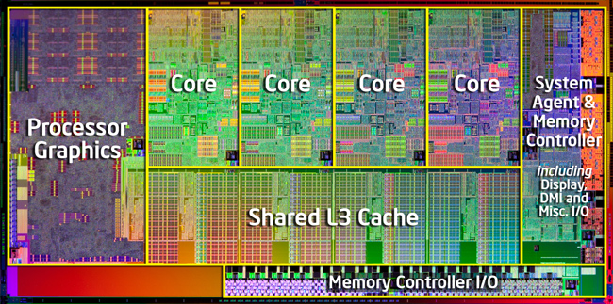
Introduction to parallel hardware.

Slide 7
General Parallel Computing Terminology
Node
A standalone "computer in a box." Usually comprised of multiple CPUs/processors/cores, memory, network interfaces, etc. Nodes are networked together to comprise a supercomputer.
CPU
Contemporary CPUs consist of one or more cores.
Process
A process is an instance of a program that is being executed or processed
Thread
Thread is a segment of a process or a lightweight process that is managed by the scheduler independently

Slide 8
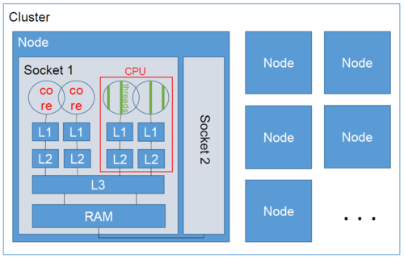
General Parallel Computing Terminology

Slide 9
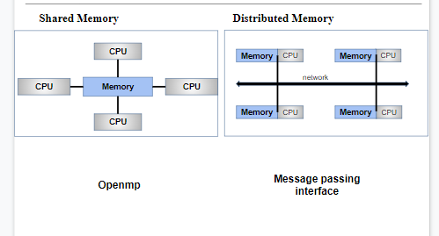
General Parallel Computing Terminology

Slide 10
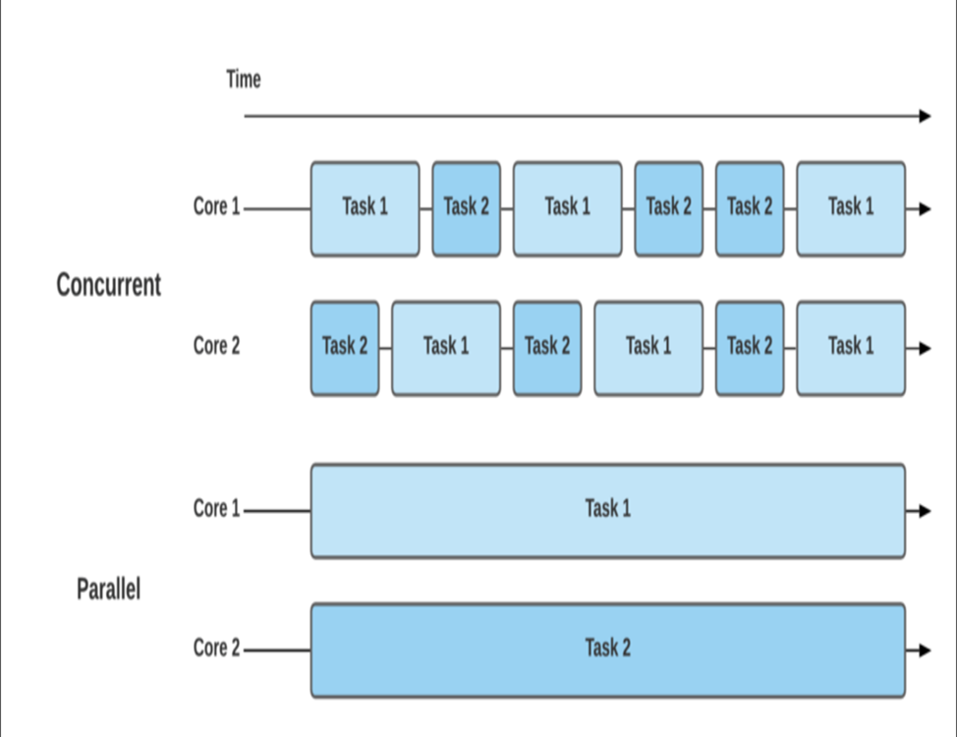
General Parallel Computing Terminology
Concurrency and Parallelism
Concurrency: A condition of a system in which multiple tasks are logically active at one time
Parallelism: A condition of a system in which multiple tasks are actually active at one time
Notes:
Concurrency:
Concurrency relates to an application that is processing more than one task at the same time. Concurrency is an approach that is used for decreasing the response time of the system by using the single processing unit. Concurrency is creates the illusion of parallelism, however actually the chunks of a task aren’t parallelly processed, but inside the application, there are more than one task is being processed at a time. It doesn’t fully end one task before it begins ensuing.
Concurrency is achieved through the interleaving operation of processes on the central processing unit(CPU) or in other words by the context switching. that’s rationale it’s like parallel processing. It increases the amount of work finished at a time.
Parallelism: Parallelism is related to an application where tasks are divided into smaller sub-tasks that are processed seemingly simultaneously or parallel. It is used to increase the throughput and computational speed of the system by using multiple processors. It enables single sequential CPUs to do lot of things “seemingly” simultaneously.
Parallelism leads to overlapping of central processing units and input-output tasks in one process with the central processing unit and input-output tasks of another process. Whereas in concurrency the speed is increased by overlapping the input-output activities of one process with CPU process of another process.

Slide 11
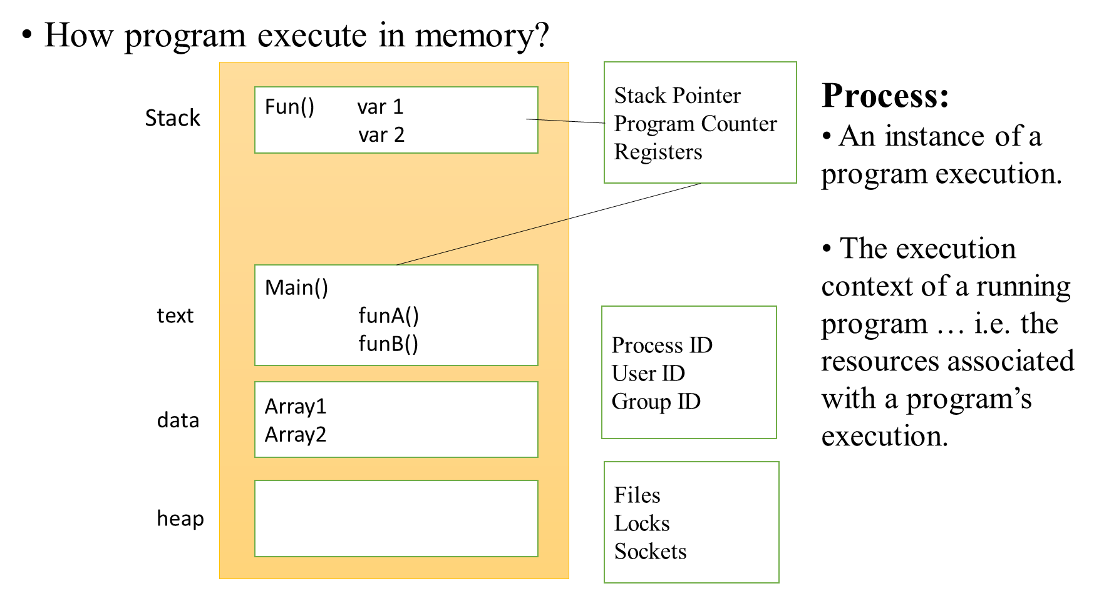
Process and Threads

Slide 12
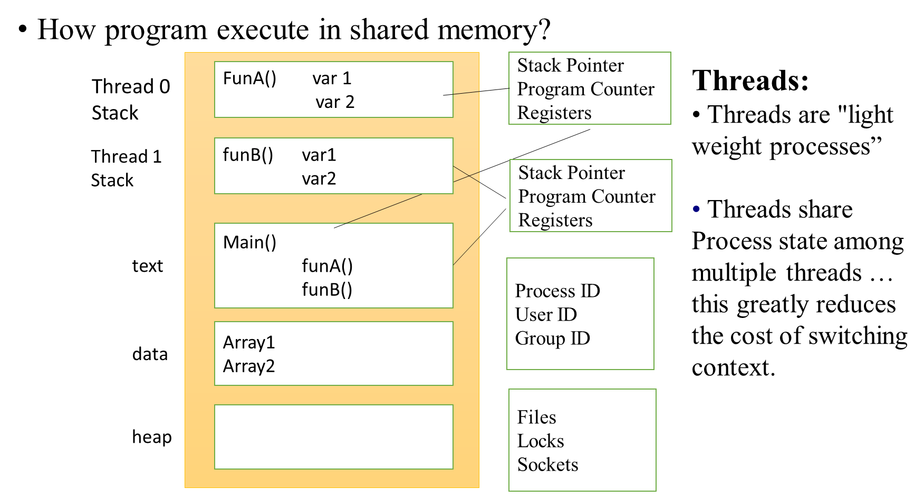
Process and Threads

Slide 13
Demo Time

Slide 14
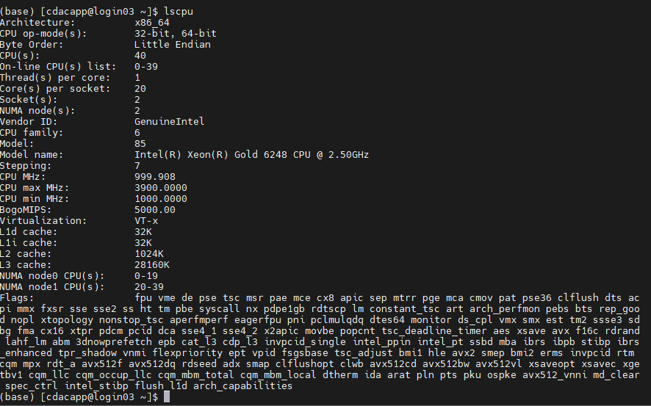
Hardware information
$lscpu or cat /proc/cpuinfo

Slide 15
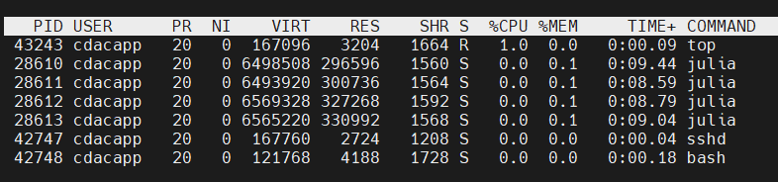
Process and Thread information
$top –u <username>

Slide 16
An Operating system’s perspective
Supports multi-core
Perceives each core as a separate processor
Scheduler maps threads/process to different cores

Slide 17
Multi-core CPU
Multi-core processor are MIMD where different cores execute different threads (MI), operating on different part of memory (Multiple data).
Multi-core is a shared memory multiprocessor (SMP) where all cores share memory

Slide 18
Thank you

Slide 19
Introduction to OPENMP
Open Multi Processing

Slide 20
Content
Introduction to openmp
What is OpenMP?
History of OpenMP
Why openmp
OpenMP Programming Model
OpenMP Stack
Hello world in openmp
Basic Syntax
Hello world c program
Compile and execution

Slide 21
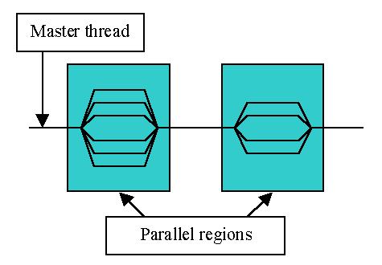
Introduction to openmp
What is OpenMP?
An Application Program Interface (API) that may be used to explicitly direct multi-threaded, shared memory parallelism
Comprises three primary API components
Compiler Directives
Runtime Library Routines
Environment Variables
Portable
The API is specified for C/C++ and Fortran
Has been implemented for most major platforms including Unix/ Linux platforms and Windows

Slide 22
Introduction to openmp
What is OpenMP? (cont.)
Standardized
Jointly defined and endorsed by a group of major computer hardware and software vendors
Expected to become an ANSI standard later???
What does OpenMP stand for?
Short version: Open Multi-Processing
Long version: Open specifications for Multi-Processing via collaborative work between interested parties from the hardware and software industry, government and academia

Slide 23
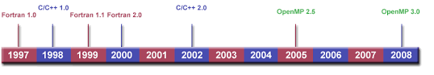
Introduction to openmp
History of OpenMP
Version 1.0 : OpenMP for Fortran 1.0, in October 1997
Version 1.0 : OpenMP for C/C++, in October 1998
Version 2.0 : OpenMP for Fortran 1.1, in 1999
Version 2.0 : OpenMP for C/C++, in 2000
Version 2.0 : OpenMP for C/C++, in 2002
Version 2.5 : OpenMP for C/C++/Fortran, in 2005

Slide 24
Introduction to openmp
History of OpenMP(cont.)
Up to version 2.0, OpenMP primarily specified ways to parallelize
highly regular loops, as they occur in matrix-oriented numerical
programming,
In Version 3.0 Included features like concept of tasks and the task
construct.
In version 4.0 openmp improved following features:
support for accelerators, atomics, error handling, thread affinity;
tasking extensions; user defined reduction, SIMD support.

Slide 25
Introduction to openmp
Why Openmp?
More efficient
Hides the low-level details.
OpenMP has directives that allow the programmer to:
specify the parallel region
specify whether the variables in the parallel section are private or shared
specify how/if the threads are synchronized
specify how to parallelize loops
specify how the works is divided between threads (scheduling)

Slide 26
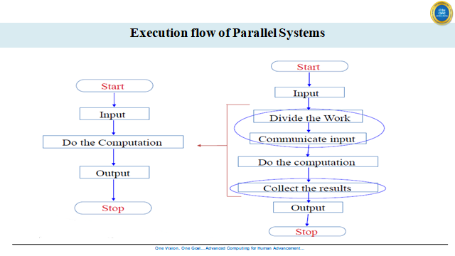

Slide 27
OpenMP Programming Model
Shared memory, thread-based parallelism
OpenMP is based upon the existence of multiple threads in the shared memory programming paradigm.
A shared memory process consists of multiple threads.
Explicit Parallelism
OpenMP is an explicit (not automatic) programming model, offering the programmer full control over parallelization.
OpenMP uses the fork-join model of parallel execution.
Compiler directive based
Most OpenMP parallelism is specified through the use of compiler directives which are imbedded in C/C++ or Fortran source code.

Slide 28
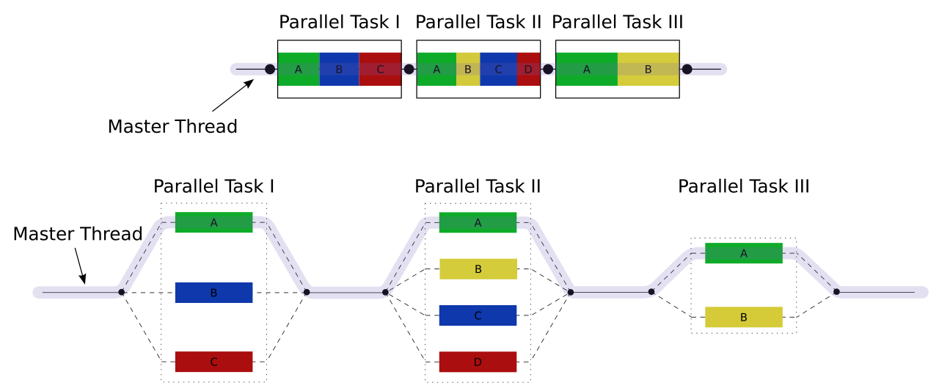
OpenMP Programming Model
Fork–join model:

Slide 29
OpenMP Programming Model
Fork–join model: (cont.)
All OpenMP programs begin as a single process: the master thread. The master thread executes sequentially until the first parallel region construct is encountered.
FORK: the master thread then creates a team of parallel threads
The statements in the program that are enclosed by the parallel region construct are then executed in parallel among the team threads.
JOIN: When the team threads complete the statements in the parallel region construct, they synchronize and terminate, leaving only the master thread

Slide 30
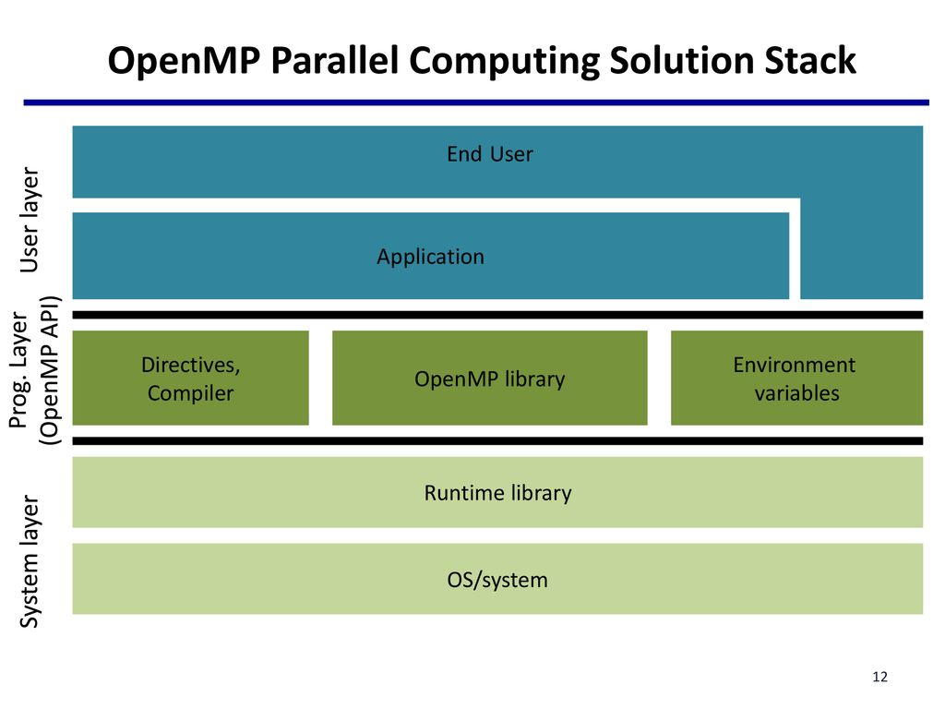
OpenMP Stack

Slide 31
Hello world in openmp
Basic Syntax
Function prototypes and types in the file:
#include <omp.h>
Most of the constructs in OpenMP are compiler directives.
#pragma omp construct [clause [clause]…]
{
//..Do some work here
}
//end of parallel region/block
Example:
#pragma omp parallel num_threads(4)

Slide 32
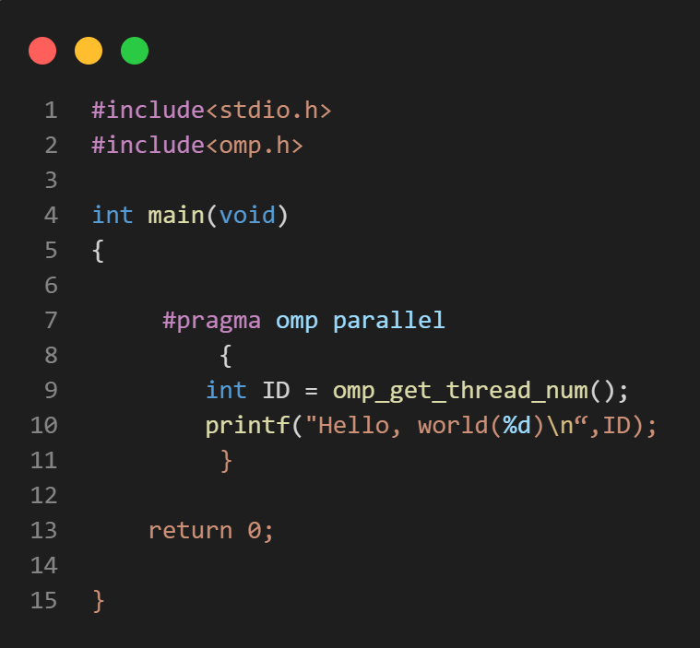
Hello world in openmp
OpenMP Hello World program using C
OpenMP Include File
Runtime library function to
return a thread ID.
Parallel region with default number of threads

Slide 33
Your first openMP program
Check your system support: locate omp.h
Compilation: g++ -fopenmp hello.c
Execution: ./a.out
Flags:
GNU: -fopenmp for Linux, Solaris, AIX, MacOS, Windows.
IBM: -qsmp=omp for windows, AIX and Linux.
Sun: -xopwnmp for Solaris and Linux
Intel: -qopenmp on Linux or Mac, or -Qopenmp on windows
PGI: -mp

Slide 34
Parallel Software Models
Programing Models

Slide 35
Hello world in openmp
Number of threads 4
Parallel Region
Tid = 0
Tid = 1
Tid = 2
Tid =3
tid is private to each thread.
Hello world Thread 0
Hello world Thread 1
Hello world Thread 2
Hello world Thread 3

Slide 36
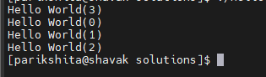
Compile and execution
Compile program in OpenMP
Set number of threads:
Using shell
$ export OMP_NUM_THREADS=4
Inside program before parallel region.
omp_set_num_threads(4);
For GNU C compiler:
$ gcc -fopenmp HelloWorld.c -o Hello
$./Hello
For Intel compiler:
$ icc -qopenmp HelloWorld.c -o Hello
$./Hello
Output of hello world program with 4 threads:

Slide 37
Thank you

Slide 38
OpenMP Components
Language extensions

Slide 39
Content
OpenMP Components
PARALLEL Region Construct.
Number of Threads
Nested Parallel Regions.
PARALLEL Region Example
Nested Parallel Region Example
Work-sharing Constructs
Do/for
Single
Section
Synchronization
Run-time Library Routines
Environment Variables

Slide 40
OpenMP Components
Directives
Runtime Environment
Runtime Variables
Parallel region
Worksharing constructs
Tasking
Offloading
Affinity
Error Handling
SIMD
Synchronization
Data-Sharing attributes
Number of threads
Thread Id
Dynamic thread adjustment
Nested parallelism
Schedule
Thread limit
Wallclock timer
Team size
Nesting level
Number of threads
Scheduling type
Dynamic thread adjusting
Nested parallelism
Thread limit

Slide 41
Parallel Region Construct
Block of code that will be executed by multiple threads
Fundamental OpenMP parallel construct
When a thread reaches a PARALLEL directive, it creates a team of threads and becomes the master of the team. The master is a member of that team and has thread number 0 within that team.
Starting from the beginning of this parallel region, the code is duplicated and all threads will execute that code.
There is an implied barrier at the end of a parallel section Only the master thread continues execution past this point.
If any thread terminates within a parallel region, all threads in the team will terminate, and the work done up until that point is undefined.

Slide 42
Parallel Region Construct
#pragma omp parallel [clause[ [, ]clause] ...] new-line
clause:
if(scalar-expression)
num_threads(integer-expression)
default(shared | none)
private(list)
firstprivate(list)
shared(list)
reduction(operator: list)

Slide 43
Parallel Region Construct
Number of Threads
The number of threads in a parallel region is determined by the following factors, in order of precedence:
1. Evaluation of the IF clause
2. Setting of the NUM_THREADS clause
3. Use of the omp_set_num_threads() library function
4. Setting of the OMP_NUM_THREADS environment variable
5. Implementation default - usually the number of cores on a node.
Threads are numbered from 0 (master thread) to N-1

Slide 44
PARALLEL Region Example
#include <omp.h>
#include <stdio.h>
int main (){
#pragma omp parallel if(omp_in_parallel)
{
printf("The threads is %d\n",omp_get_thread_num());
}
return 0;
}
How to compile and run?
$gcc -fopenmp <file_name.c> -o <file_name>
$./<file_name>
[cdacapp2@login3 1.If]$ ./mp_if
The threads is 0
The threads is 2
The threads is 3
The threads is 1

Slide 45
Parallel Region Construct
Nested Parallel Regions
Use the omp_get_nested() library function to determine
if nested parallel regions are enabled.
The two methods available for enabling nested parallel regions (if supported) are:
The omp_set_nested() library routine
Setting of the OMP_NESTED environment variable to TRUE
If not supported, a parallel region nested within another parallel region results in the creation of a new team, consisting of one thread, by default.

Slide 46
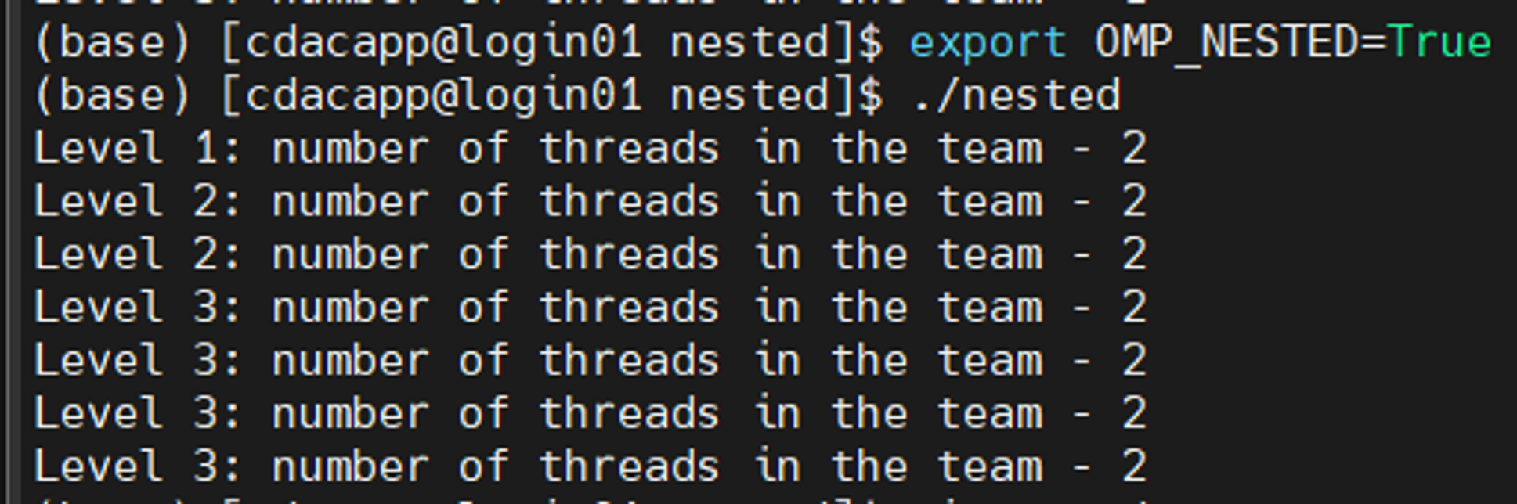
PARALLEL Nested Region Example
#include <omp.h>
#include <stdio.h>
void report_num_threads(int level)
{
#pragma omp single
{
printf("Level %d: number of threads in the team - %d\n",
level, omp_get_num_threads());
}
}
int main()
{
omp_set_dynamic(0);
#pragma omp parallel num_threads(2)
{
report_num_threads(1);
#pragma omp parallel num_threads(2)
{
report_num_threads(2);
#pragma omp parallel num_threads(2)
{
report_num_threads(3);
}
}
}
return(0);
}
How to compile and run?
$gcc -fopenmp <file_name.c> -o <file_name>
$./<file_name>

Slide 47
Run-time Library Routines
The OpenMP standard defines an API for library calls that perform a variety of functions:
Query the number of threads/processors, set number of threads to use
General purpose locking routines (semaphores)
Portable wall clock timing routines
Set execution environment functions: nested parallelism, dynamic adjustment of threads.
For C/C++, it may be necessary to specify the include file
"omp.h”.
Note: Your implementation may or may not support nested parallelism and/or dynamic threads. If nested parallelism is supported, it is often only nominal, in that a nested parallel region may only have one thread.

Slide 48
OpenMP Environment Variables
To set number of threads during execution
export OMP_NUM_THREDS=4
To allow run time system to determine the number of threads
export OMP_DYNAMIC=TRUE
To allow nesting of parallel region
export OMP_NESTED=TRUE

Slide 49
Data Scope Attribute Clauses
Also called data sharing attribute clauses
Because OpenMP is based upon the shared memory programming
model, most variables are shared by default.
Global variables include:
C: File scope variables, static
Private variables include:
Loop index variables
Clauses used to explicitly define how variables should be scoped
include:
PRIVATE
FIRSTPRIVATE
LASTPRIVATE
SHARED
DEFAULT
REDUCTION
COPYIN

Slide 50
Data Scope Attribute Clauses (cont.)
Used in conjunction with several directives (PARALLEL, DO/for, and SECTIONS) to control the scoping of enclosed variables.
Provide the ability to control the data environment during execution of parallel constructs
Define how and which data variables in the serial section of the program are transferred to the parallel sections of the program (and back)
Define which variables will be visible to all threads in the parallel sections and which variables will be privately allocated to all threads
Effective only within their lexical/static extent

Slide 51
PRIVATE and SHARED Clauses
PRIVATE Clause
Declares variables in its list to be private to each thread
A new object of the same type is declared once for each thread in the team.
All references to the original object are replaced with references to the new object.
Variables declared PRIVATE should be assumed to be uninitialized for each thread.
SHARED Clause
Declares variables in its list to be shared among all threads in the team
A shared variable exists in only one memory location and all threads can read or write to that address.
It is the programmer's responsibility to ensure that multiple threads properly access SHARED variables (such as via CRITICAL sections)

Slide 52
FIRSTPRIVATE and LASTPRIVATE Clauses
FIRSTPRIVATE Clause
Combines the behaviour of the PRIVATE clause with automatic initialization of the variables in its list
Listed variables are initialized according to the value of their original objects prior to entry into the parallel or work-sharing construct.
LASTPRIVATE Clause
Combines the behaviour of the PRIVATE clause with a copy from the last loop iteration or section to the original variable object
The value copied back into the original variable object is obtained from the last (sequentially) iteration or section of the enclosing construct.
For example, the team member that executes the final iteration
for a DO section, or the team member that executes the last SECTION of a SECTIONS context, performs the copy with its own values.

Slide 53
DEFAULT Clause
Allows the user to specify a default scope for all variables in the lexical extent of any parallel region
Specific variables can be exempted from the default using the PRIVATE, SHARED, FIRSTPRIVATE, LASTPRIVATE, and REDUCTION clauses.
The C/C++ OpenMP specification does not include private or firstprivate as a possible default. However, actual implementations may provide this option.
Using NONE as a default requires that the programmer explicitly scope all variables.

Slide 54
Work-sharing Constructs
A work-sharing construct divides the execution of the enclosed code region among the members of the team that encounter it.
Work-sharing constructs do not launch new threads
There is no implied barrier upon entry to a work-sharing construct, however there is an implied barrier at the end of a work sharing construct.
A work-sharing construct must be enclosed dynamically within a parallel region in order for the directive to execute in parallel.
Work-sharing constructs must be encountered by all members of a team or none at all
Successive work-sharing constructs must be encountered in the same order by all members of a team.

Slide 55
Types of Work-sharing Constructs
DO / for
Shares iterations of a loop across the team
Represents a type of "data parallelism”
SECTIONS
Breaks work into separate, discrete sections
Each section is executed by a thread.
Can be used to implement a type of "functional parallelism”
SINGLE
Serializes a section of code

Slide 56
For Directive Syntax
#pragma omp for [clause[[,] clause] ... ] new-line
for-loops
clause:
private(list)
firstprivate(list)
lastprivate(list)
reduction(operator: list)
schedule(kind[, chunk_size])
ordered
nowait

Slide 57
For loop
The for construct tells OpenMP that the iteration set of the for loop that follows is to be distributed across the threads present in the team. Without the for construct, the entire iteration set of the for loop concerned will be executed by each thread in the team.
The for directive supports the following clauses:
private
firstprivate
lastprivate
reduction
ordered
schedule
Nowait
How iteration are divide in threads?
0 - N-1

Slide 58
For loop - PRIVATE
The values of private data are undefined upon entry to and exit from the specific construct.
Loop iteration variable is private by default.
How to compile and run?
$gcc -fopenmp <file_name.c> -o <file_name>
$./<file_name>
$ ./for_private
The thread 0 value is 0
The thread 0 value is 30
The thread 1 value is 0
The thread 1 value is 30
The thread 3 value is 0
The thread 3 value is 30
The thread 4 value is 0
The thread 4 value is 30
The thread 2 value is 0
The thread 2 value is 30
Notes:
In real-life implementations, the private clause in OpenMP is used to ensure thread safety and prevent data races when multiple threads are accessing and modifying shared variables.
Task-based Parallelism:
In task-based parallel programming models, such as OpenMP tasks, the private clause is often used to create private variables for each task. Each task can have its own private data and local variables, ensuring that tasks work independently and do not conflict with each other's data.

Slide 59
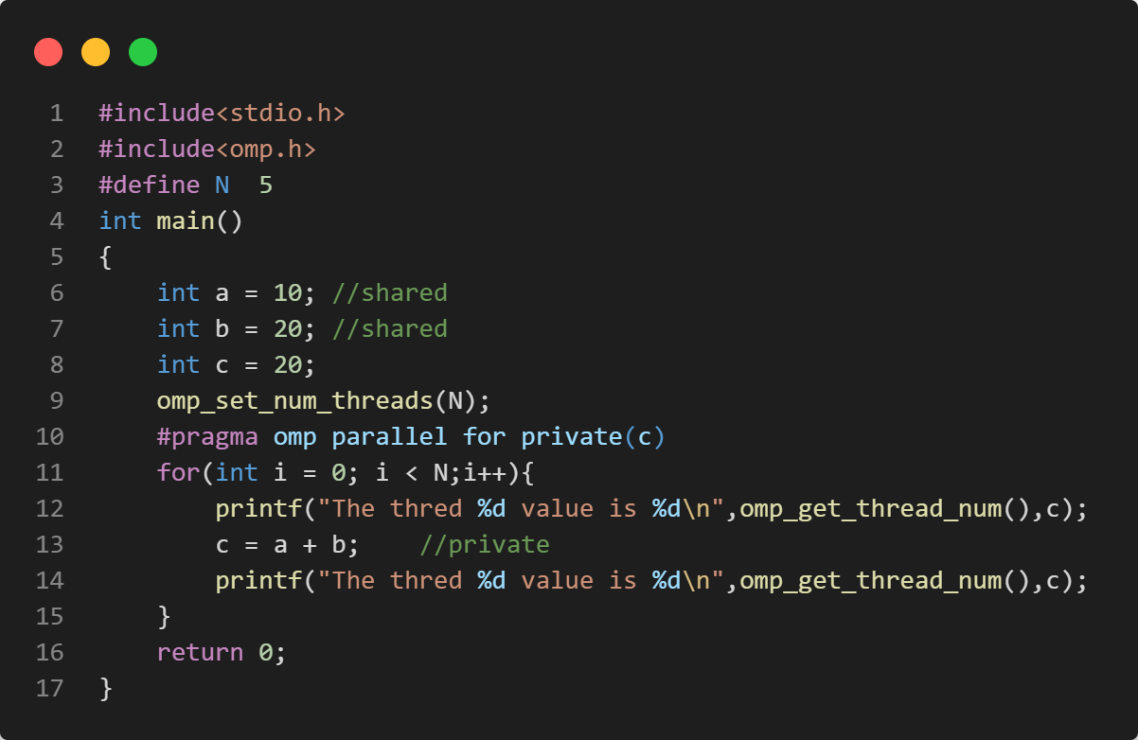
For loop - PRIVATE

Slide 60
For loop - FIRSTPRIVATE
The clause combines behaviour of private clause with automatic initialization of the variables in its list.
How to compile and run?
$gcc -fopenmp <file_name.c> -o <file_name>
$./<file_name>
$ ./for_firstprivate
The thred 0 value is 20
The thred 0 value is 30
The thred 4 value is 20
The thred 4 value is 30
The thred 3 value is 20
The thred 3 value is 30
The thred 2 value is 20
The thred 2 value is 30
The thred 1 value is 20
The thred 1 value is 30
Notes:
In addition to the private clause, OpenMP also provides the firstprivate clause, which combines the functionality of both private and initialization. The firstprivate clause allows you to declare a variable as private to each thread while also initializing it with the value it had before entering the parallel region. This clause is commonly used when you want to ensure that each thread has a private copy of a variable and starts with the same initial value.

Slide 61
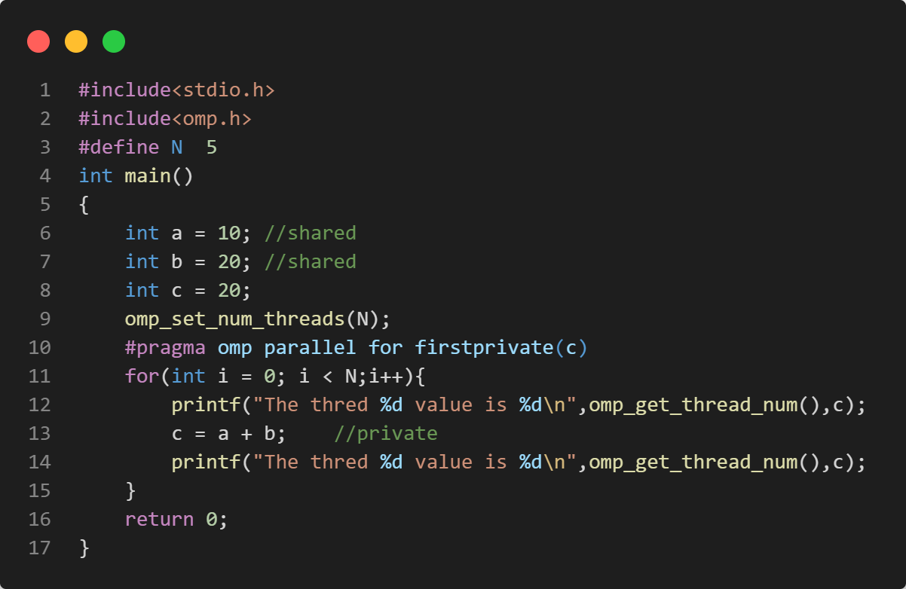
For loop - FIRSTPRIVATE

Slide 62
For loop - LASTPRIVATE
Performs finalization of private variables
Each thread has its own copy
How to compile and run?
$gcc -fopenmp <file_name.c> -o <file_name>
$./<file_name>
$ ./for_lastprivate
The thred 4 value is 30
The thred 2 value is 30
The thred 1 value is 30
The thred 3 value is 30
The thred 0 value is 30
The thred 0 value is 30
Notes:
In OpenMP, the lastprivate clause is used to ensure that the last private value of a variable is assigned to the original shared variable after the parallel region completes. This clause is useful when you want to retain the final value of a variable computed in a parallel loop.

Slide 63
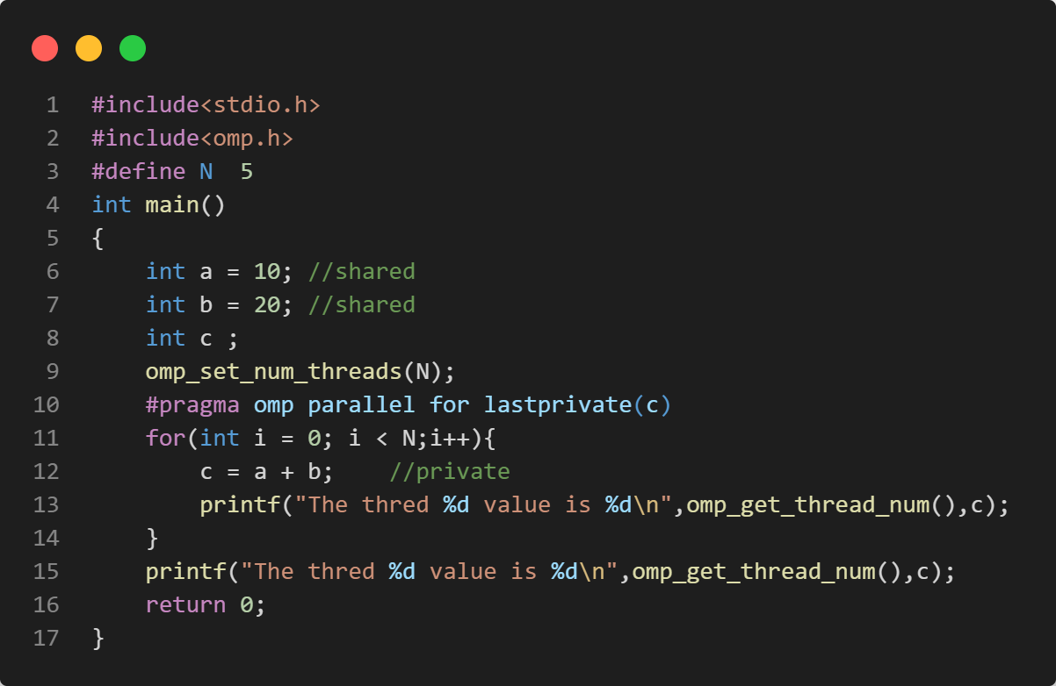
For loop - LASTPRIVATE

Slide 64
REDUCTION Clause
Performs a reduction on the variables that appear in its list.
A private copy for each list variable is created for each thread. At the end of the reduction, the reduction operator is applied to all private copies of the shared variable, and the final result is written to the global shared variable.
Syntax:
reduction (operator: list)

Slide 65
For loop - REDUCTION
The reduction clause indicates that the variables passed are, as its name suggests, used in a reduction.
By default, the reduction computation is complete at the end of the construct.
How to compile and run?
$gcc -fopenmp <file_name.c> -o <file_name>
$./<file_name>
$ ./reduction
Number of primes numbers: 5761455

Slide 66
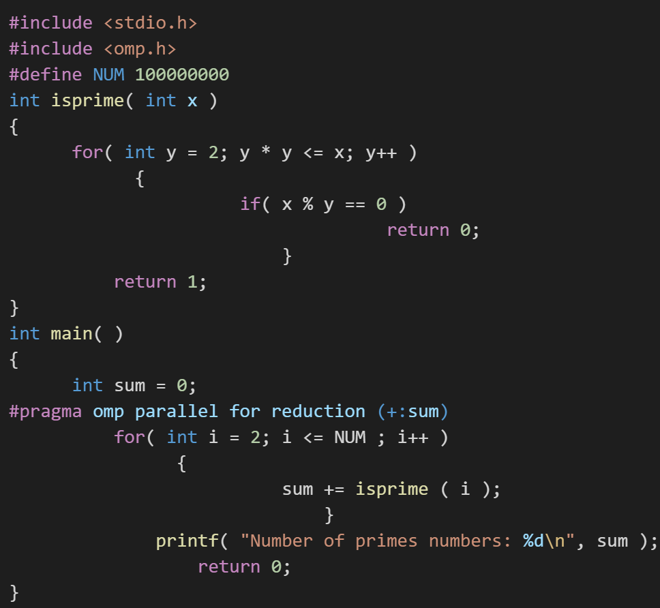
For loop - REDUCTION

Slide 67
For loop - ORDERED
The omp ordered directive identifies a structured block of code that must be executed in sequential order.
$ ./ordered
Thread 1 processes iteration 3.
Thread 1 processes iteration 4.
Thread 1 processes iteration 5.
Thread 2 processes iteration 6.
Thread 2 processes iteration 7.
Thread 0 processes iteration 0.
Thread 0 processes iteration 1.
Thread 0 processes iteration 2.
Thread 3 processes iteration 8.
Thread 3 processes iteration 9.
How to compile and run?
$gcc -fopenmp <file_name.c> -o <file_name>
$./<file_name>

Slide 68
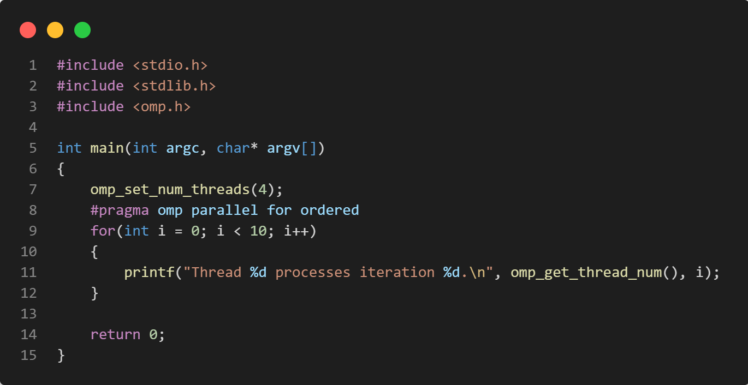
For loop - ORDERED

Slide 69
For loop - SCHEDULE
The schedule clause tells OpenMP how to distribute the loop iterations to the threads.
The OpenMP scheduling kind to use.
Possible values:
auto: the auto scheduling kind will apply.
dynamic: the dynamic scheduling kind will apply.
guided: the guided scheduling kind will apply.
runtime: the runtime scheduling kind will apply.
static: the static scheduling kind will apply.

Slide 70
SCHEDULE Clause.. cont
schedule(static, [n])
Each thread is assigned chunks in “round robin” fashion, known as block cyclic scheduling.
divides iterations into chunks that are approximately equal in size and it distributes at most one chunk to each thread
If n has not been specified, it will contain
CEILING(number_of_iterations / number_of_threads) iterations
Example: loop of length 16, 3 threads, chunk size 2 :
Notes:
static: Divides the iterations into chunks of equal size, and each thread is assigned a contiguous block of iterations. The chunk size is determined by the chunksize parameter or by the compiler.

Slide 71
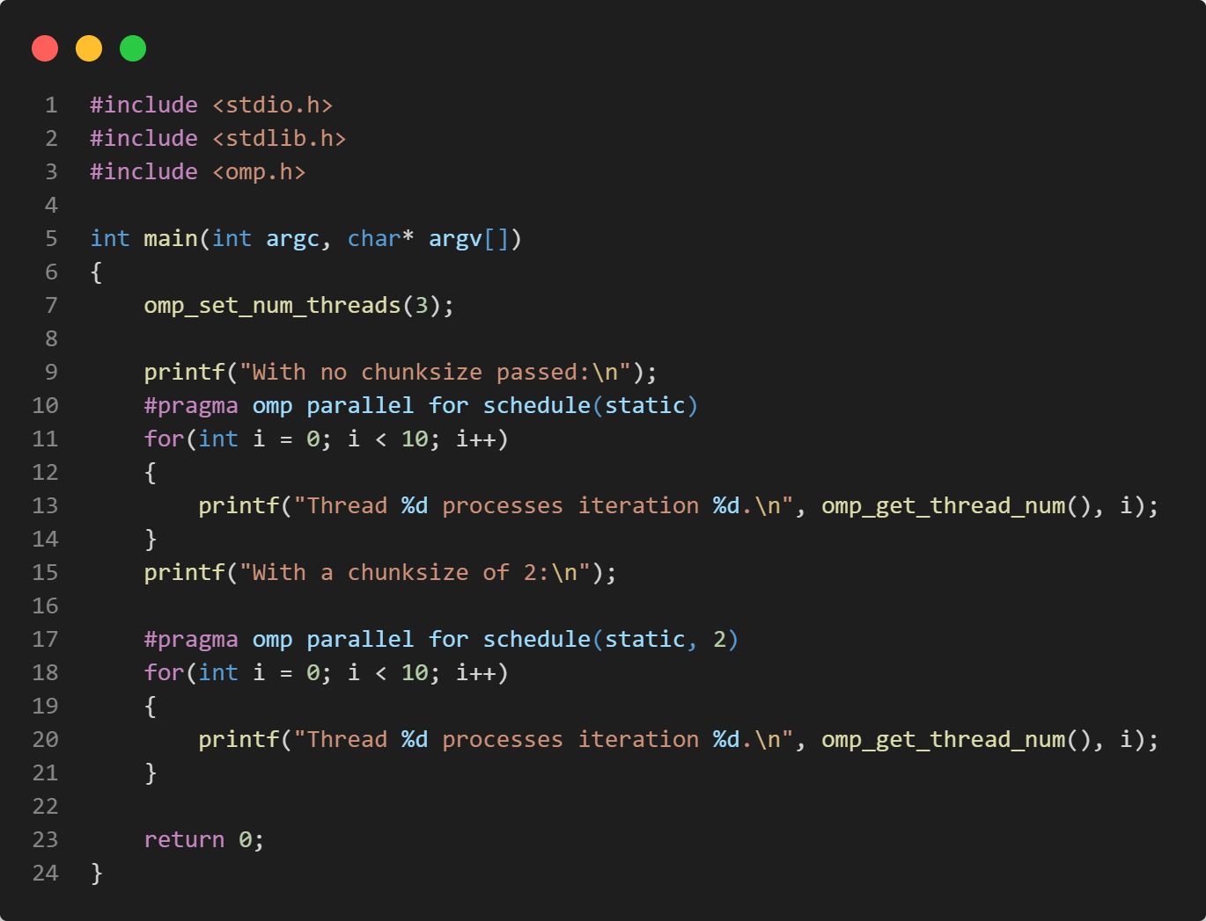
For loop - SCHEDULE(static)
$ ./parallel_for
With no chunksize passed:
Thread 0 processes iteration 0.
Thread 0 processes iteration 1.
Thread 0 processes iteration 2.
Thread 2 processes iteration 7.
Thread 2 processes iteration 8.
Thread 2 processes iteration 9.
Thread 0 processes iteration 3.
Thread 1 processes iteration 4.
Thread 1 processes iteration 5.
Thread 1 processes iteration 6.
With a chunksize of 2:
Thread 1 processes iteration 2.
Thread 1 processes iteration 3.
Thread 1 processes iteration 8.
Thread 1 processes iteration 9.
Thread 2 processes iteration 4.
Thread 2 processes iteration 5.
Thread 0 processes iteration 0.
Thread 0 processes iteration 1.
Thread 0 processes iteration 6.
Thread 0 processes iteration 7.
How to compile and run?
$gcc -fopenmp <file_name.c> -o <file_name>
$./<file_name>

Slide 72
Static
The nice thing with static scheduling is that OpenMP run-time guarantees that if you have two separate loops with the same number of iterations and execute them with the same number of threads using static scheduling, then each thread will receive exactly the same iteration range(s) in both parallel regions.
This is quite important on NUMA systems: if you touch some memory in the first loop, it will reside on the NUMA node where the executing thread was. Then in the second loop the same thread could access the same memory location faster since it will reside on the same NUMA node.

Slide 73
For loop - SCHEDULE(dynamic)
schedule(dynamic, [n])
Divides the iterations into chunks of equal size, but each thread can be assigned a different chunk of iterations dynamically at runtime until no chunk remain to be distributed.
The chunk size is determined by the chunksize parameter or by the compiler.
There is no particular order in which the chunks are distributed to the threads. The order changes each time when we execute the for loop.

Slide 74
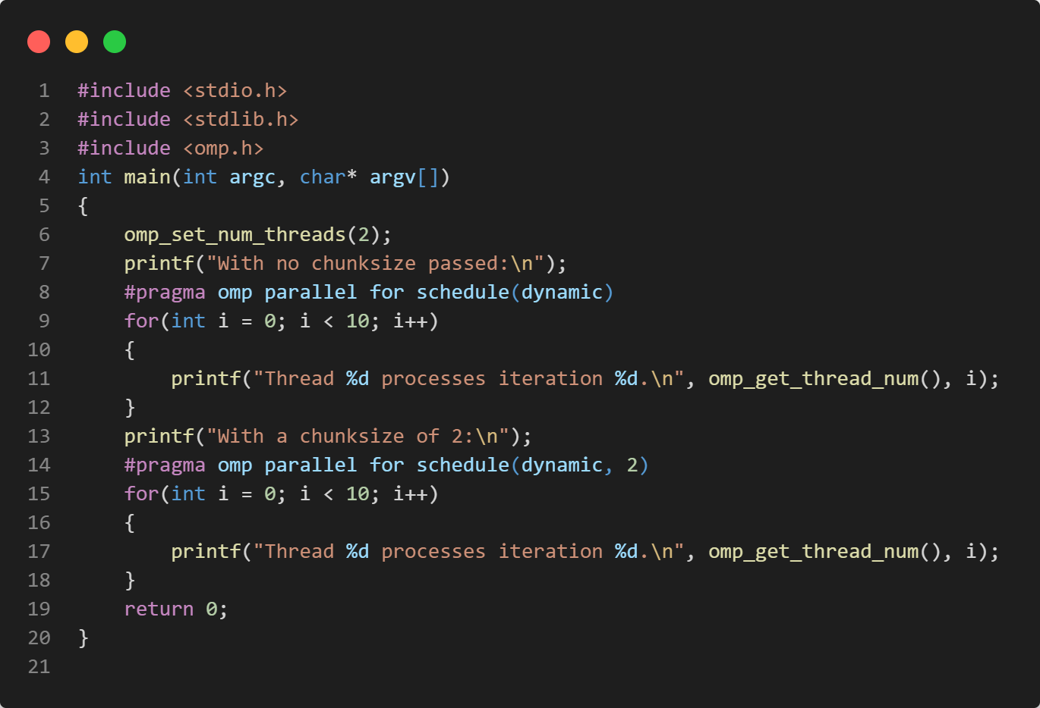
For loop - SCHEDULE(dynamic)
$ ./parallel_for_loop
With no chunksize passed:
Thread 0 processes iteration 0.
Thread 0 processes iteration 2.
Thread 0 processes iteration 3.
Thread 0 processes iteration 4.
Thread 0 processes iteration 5.
Thread 0 processes iteration 6.
Thread 0 processes iteration 7.
Thread 0 processes iteration 8.
Thread 0 processes iteration 9.
Thread 1 processes iteration 1.
schedule(dynamic, [n])
Iteration of loop are divided into chunks containing n iterations each.
With a chunksize of 2:
Thread 1 processes iteration 0.
Thread 1 processes iteration 1.
Thread 1 processes iteration 4.
Thread 1 processes iteration 5.
Thread 1 processes iteration 6.
Thread 1 processes iteration 7.
Thread 1 processes iteration 8.
Thread 1 processes iteration 9.
Thread 0 processes iteration 2.
Thread 0 processes iteration 3.
How to compile and run?
$gcc -fopenmp <file_name.c> -o <file_name>
$./<file_name>
Default chunk size is 1.

Slide 75
SCHEDULE Clause.. cont
schedule(guided, [n])
If you specify n, that is the minimum chunk size that each thread should posses..
Size of each successive chunk is exponentially decreasing.
The size of a chunk is proportional to the number of unassigned iterations divided by the number of the threads. Therefore the size of the chunks decreases.
Initial chunk size
max(number_of_iterations / number_of_threads,n)
Subsequent chunk consist of
max(remaining_iterations/number_of_threds,n) iterations
Schedule(runtime):export OMP_SCHEDULE “STATIC,4”
Determine the scheduling type at run time by the OMP_SCHEDULE environment variable.

Slide 76
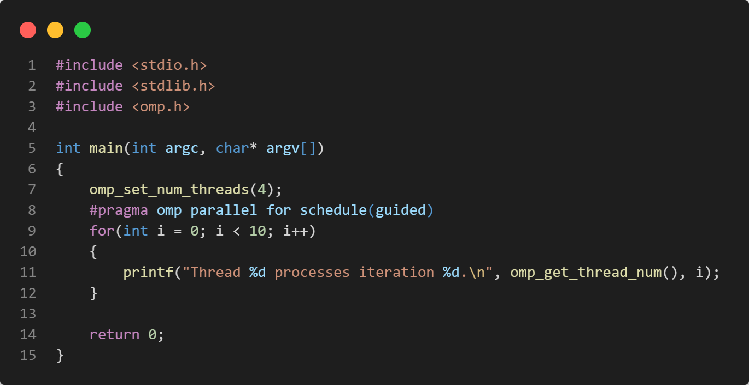
For loop - SCHEDULE(guided)
$ ./parallel_loop_scheduling
Thread 2 processes iteration 7.
Thread 2 processes iteration 8.
Thread 2 processes iteration 9.
Thread 1 processes iteration 5.
Thread 1 processes iteration 6.
Thread 3 processes iteration 3.
Thread 3 processes iteration 4.
Thread 0 processes iteration 0.
Thread 0 processes iteration 1.
Thread 0 processes iteration 2.
How to compile and run?
$gcc -fopenmp <file_name.c> -o <file_name>
$./<file_name>

Slide 77
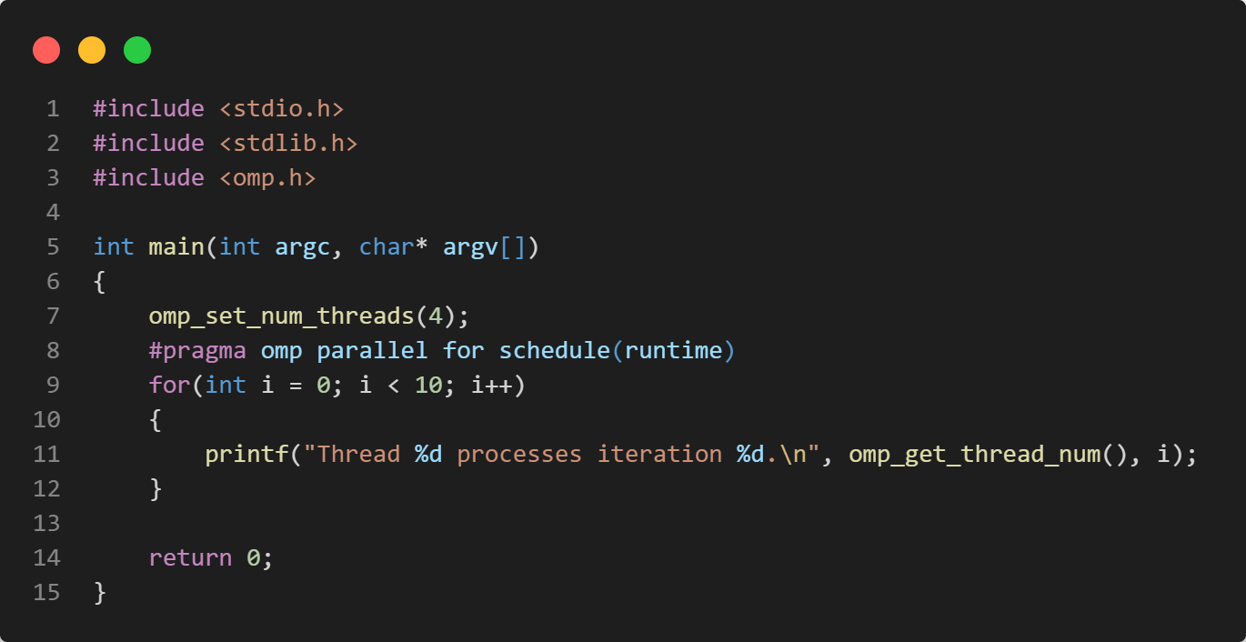
For loop - SCHEDULE(runtime)
$./parallel_for_runtime
Thread 0 processes iteration 0.
Thread 0 processes iteration 4.
Thread 0 processes iteration 5.
Thread 0 processes iteration 6.
Thread 0 processes iteration 7.
Thread 0 processes iteration 8.
Thread 1 processes iteration 3.
Thread 2 processes iteration 2.
Thread 0 processes iteration 9.
Thread 3 processes iteration 1.
How to compile and run?
$gcc -fopenmp <file_name.c> -o <file_name>
$./<file_name>

Slide 78
SECTIONS Construct
The sections construct is a non-iterative worksharing construct that contains a set of structured blocks.
The block are distributed among and executed by the threads in a team.
Each structured block is executed once by one of the threads in the team in the context of its implicit task.
The parallel directive supports the following clauses:
private(list)
firstprivate(list)
lastprivate([modifier :] list)
reduction([modifier,] identifier : list)
nowait

Slide 79
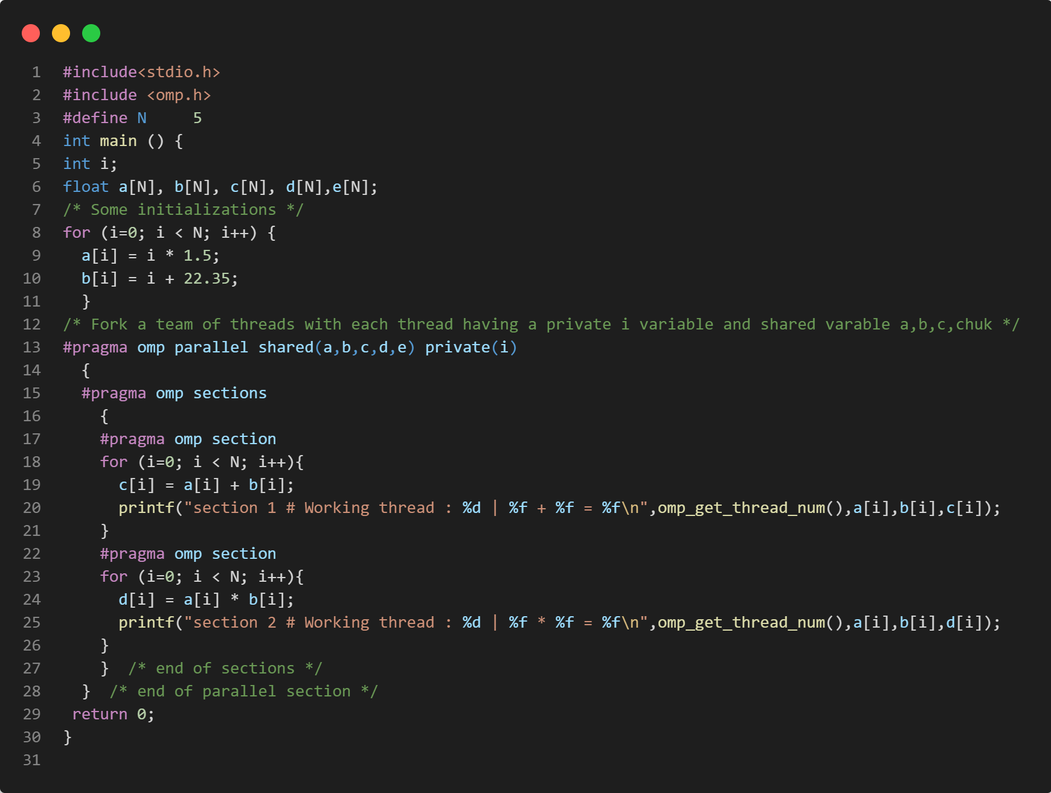
SECTIONS - PRIVATE
$./sections
section 2 # Working thread : 2 | 0.000000 * 22.350000 = 0.000000
section 2 # Working thread : 2 | 1.500000 * 23.350000 = 35.025002
section 2 # Working thread : 2 | 3.000000 * 24.350000 = 73.050003
section 2 # Working thread : 2 | 4.500000 * 25.350000 = 114.075005
section 2 # Working thread : 2 | 6.000000 * 26.350000 = 158.100006
section 1 # Working thread : 0 | 0.000000 + 22.350000 = 22.350000
section 1 # Working thread : 0 | 1.500000 + 23.350000 = 24.850000
section 1 # Working thread : 0 | 3.000000 + 24.350000 = 27.350000
section 1 # Working thread : 0 | 4.500000 + 25.350000 = 29.850000
section 1 # Working thread : 0 | 6.000000 + 26.350000 = 32.349998
How to compile and run?
$gcc -fopenmp <file_name.c> -o <file_name>
$./<file_name>

Slide 80
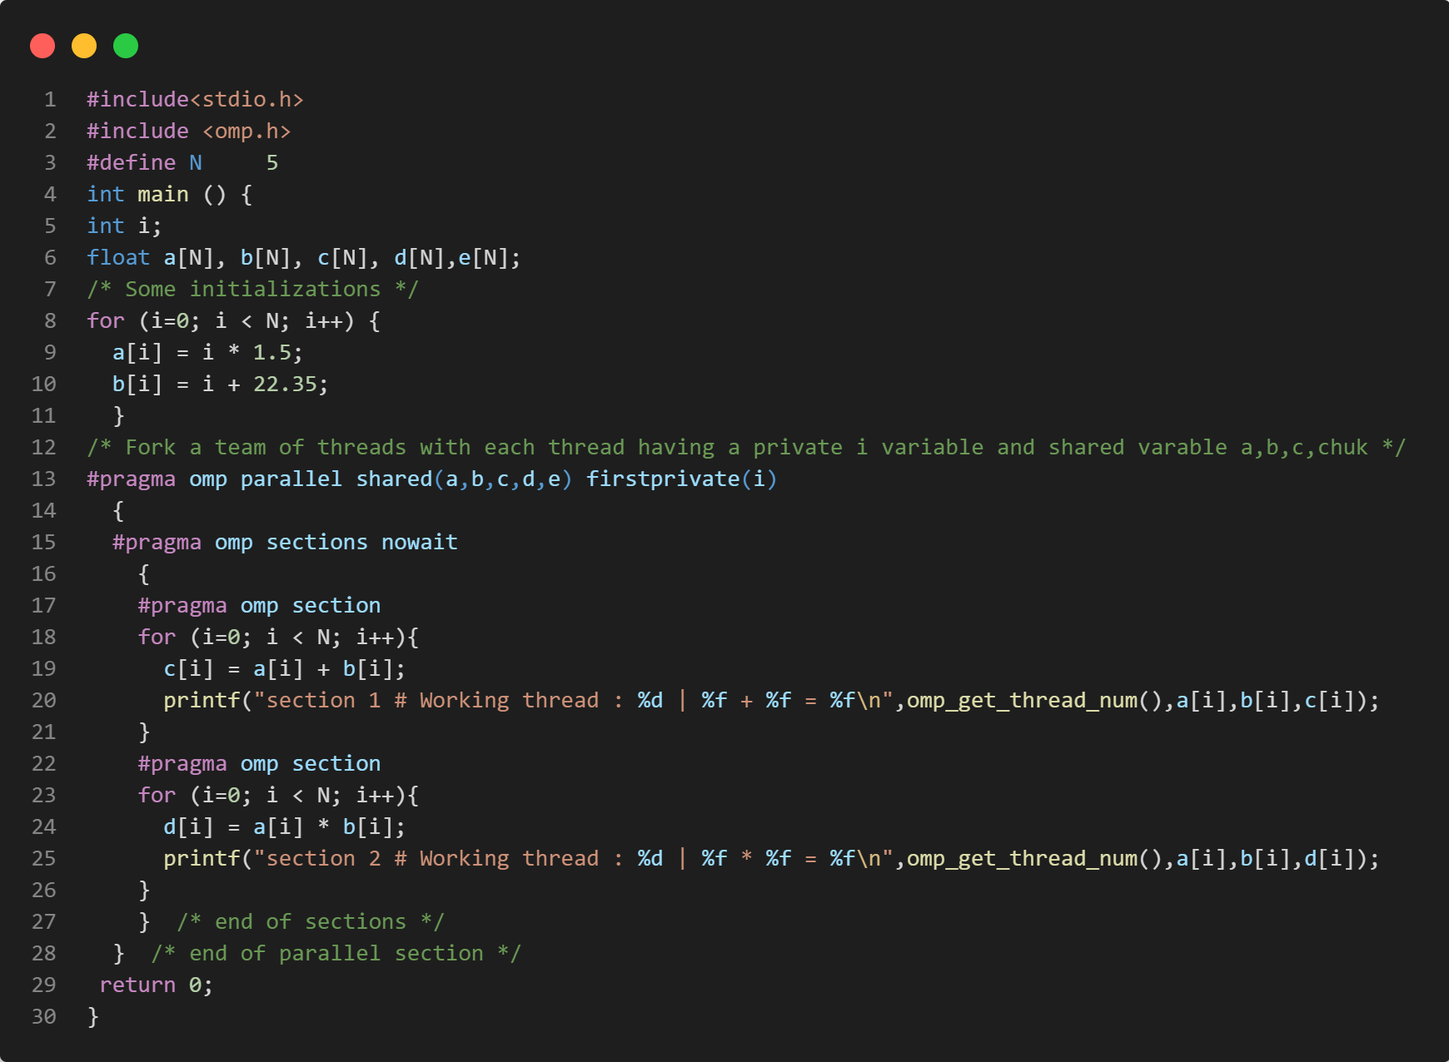
SECTIONS - FIRSTPRIVATE
$ ./sections
section 2 # Working thread : 2 | 0.000000 * 22.350000 = 0.000000
section 2 # Working thread : 2 | 1.500000 * 23.350000 = 35.025002
section 2 # Working thread : 2 | 3.000000 * 24.350000 = 73.050003
section 2 # Working thread : 2 | 4.500000 * 25.350000 = 114.075005
section 2 # Working thread : 2 | 6.000000 * 26.350000 = 158.100006
section 1 # Working thread : 0 | 0.000000 + 22.350000 = 22.350000
section 1 # Working thread : 0 | 1.500000 + 23.350000 = 24.850000
section 1 # Working thread : 0 | 3.000000 + 24.350000 = 27.350000
section 1 # Working thread : 0 | 4.500000 + 25.350000 = 29.850000
section 1 # Working thread : 0 | 6.000000 + 26.350000 = 32.349998
How to compile and run?
$gcc -fopenmp <file_name.c> -o <file_name>
$./<file_name>

Slide 81
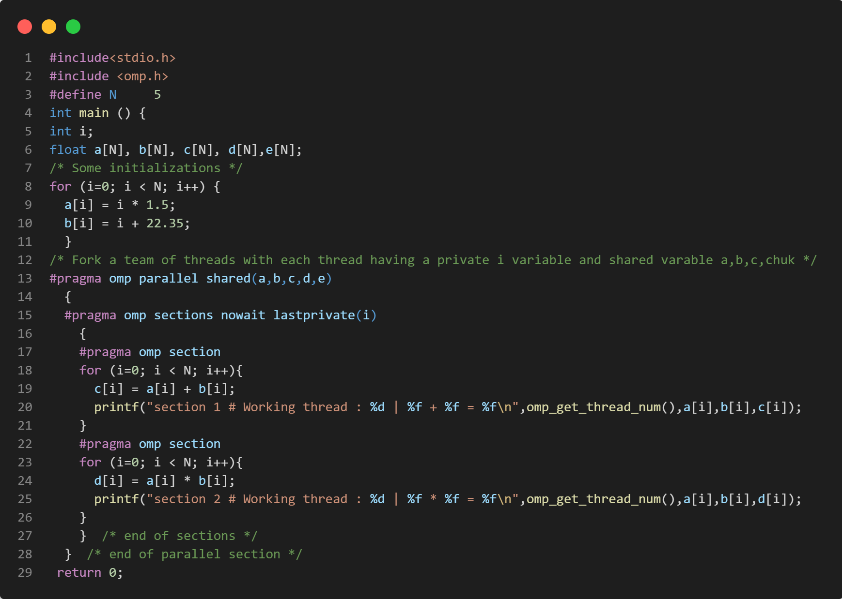
SECTIONS - LASTPRIVATE
$ ./sections
section 1 # Working thread : 0 | 0.000000 + 22.350000 = 22.350000
section 1 # Working thread : 0 | 1.500000 + 23.350000 = 24.850000
section 1 # Working thread : 0 | 3.000000 + 24.350000 = 27.350000
section 1 # Working thread : 0 | 4.500000 + 25.350000 = 29.850000
section 1 # Working thread : 0 | 6.000000 + 26.350000 = 32.349998
section 2 # Working thread : 1 | 0.000000 * 22.350000 = 0.000000
section 2 # Working thread : 1 | 1.500000 * 23.350000 = 35.025002
section 2 # Working thread : 1 | 3.000000 * 24.350000 = 73.050003
section 2 # Working thread : 1 | 4.500000 * 25.350000 = 114.075005
section 2 # Working thread : 1 | 6.000000 * 26.350000 = 158.100006
How to compile and run?
$gcc -fopenmp <file_name.c> -o <file_name>
$./<file_name>

Slide 82
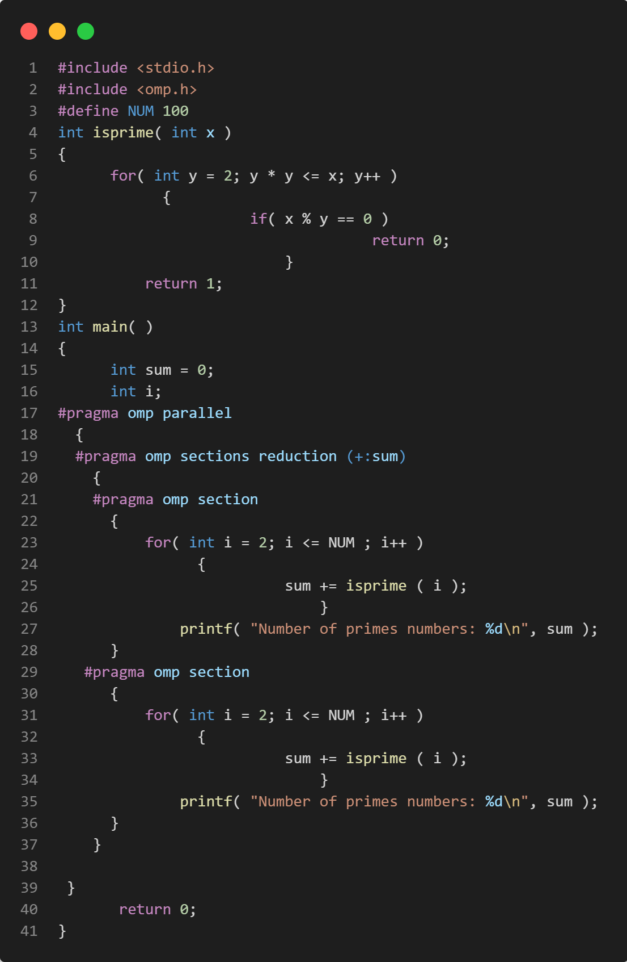
SECTIONS - REDUCTION
How to compile and run?
$gcc -fopenmp <file_name.c> -o <file_name>
$./<file_name>
$ ./reduction
Number of primes numbers: 25
Number of primes numbers: 25

Slide 83
Thank You

